Slide 1
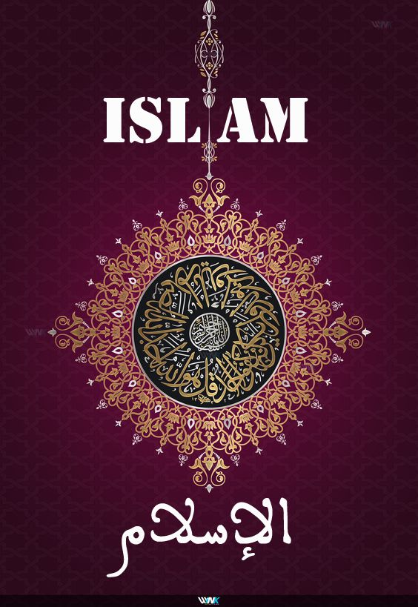
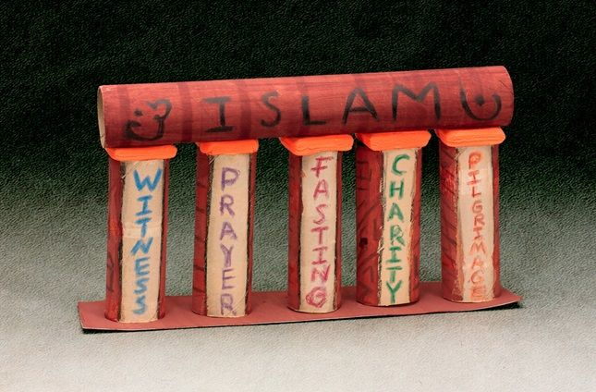
Introduction to Islam

Slide 2
Etymology of Word اسلام
Word “Islam اسلام is an Arabic word derived from another Arabic word “Salam سلام )” without Alif (الف) which literally means "Peace" and "Safeness".
As per the linguistic rules of Arabic, another letter “Alif (الف is added to it and it turned “Islam (اسلام )” which is the title of the religion.
After “Alif الف)” is added, the word is changed now and obviously the meanings as well. So, it is no more in the sense of “peace & safeness” now, instead, it stands for "Obedience", "Submission" and "Surrender".

Slide 3
Definition & Concept
"A complete code of life set and revealed by Allah (The Creator, the Owner & the Lord) to His Prophets & Messengers (From Adam (AS) to the last of His messengers MUHAMMAD (صلى الله عليه وسلم
from time to time to guide His slaves (Mankind & Jinn) to the success in life and afterlife".

Slide 4
Important Note
Islam is unlike other religions as they contain some typical traditions and customs particularly at three occasions i.e. the birth of a child, the marriage and the death of a person, or maximum some rituals are being performed as worships. They do not have systematic and organized structure of worships, social dealings, economical system, political and legal affairs based upon their religion
On the other hand, Islam is a complete code of life and is fully equipped with teachings for every aspect of life. For instance, along with above mentioned disciplines of life, Islam also stresses upon daily routine of life such as eating, drinking, sleeping, dressing, and also commands to perform the necessities of daily life as per the commandments of Islam.

Slide 5
The Subject of Islam
The Subject refers towards the study of some particular thing or object which, as a topic, is discussed under a discipline. For example, human body is discussed under medical science. Therefore, it is the subject of medical science. And machine is the subject of engineering because it is discussed under the discipline of engineering.
In the same way, when Islam is considered as a discipline and the code for life, definitely there should be some subject to be discussed in it too. And the subject for the entire Islamic teachings is…
"The human beings and Jinn being slaves to Allah the Exalted", Allah the Exalted says;
: وَمَا خَلَقْتُ الْجِنَّ وَ الْانْسَ اِلَّا لِيَعْبُدُوْنِ
“I did not create mankind and Jinn except for the Purpose that they should worship me.”
Islam reveals the teachings through which human beings may enable themselves to become good slaves to Almighty Allah.

Slide 6
The Objective of Islam
The objective behind this revelation of Islam is. . . .
"To provide complete guidance to mankind and Jinn that leads them to the success in life and afterlife".
Important Note:
A noteworthy point should also be remembered that the actual concept of success, as per the interpretation of divine scripture Al-Qur’an, lies down with safe removal from the fire of hell and the entrance into paradise. Allah says….
فَمَنْ زُحْزِحَ عَنِ ٱلنَّارِ وَأُدْخِلَ ٱلْجَنَّةَ فَقَدْ فَازَ ،وَما ٱلْحَيَاةُ ٱلدُّنْيَا إِلّْا مَتَاعُ ٱلْغُرُورِ
"So, whoever is safely removed from the fire of Hell and admitted to Paradise, he succeeded indeed. And the worldly life is not but the goods of delusion".

Slide 7
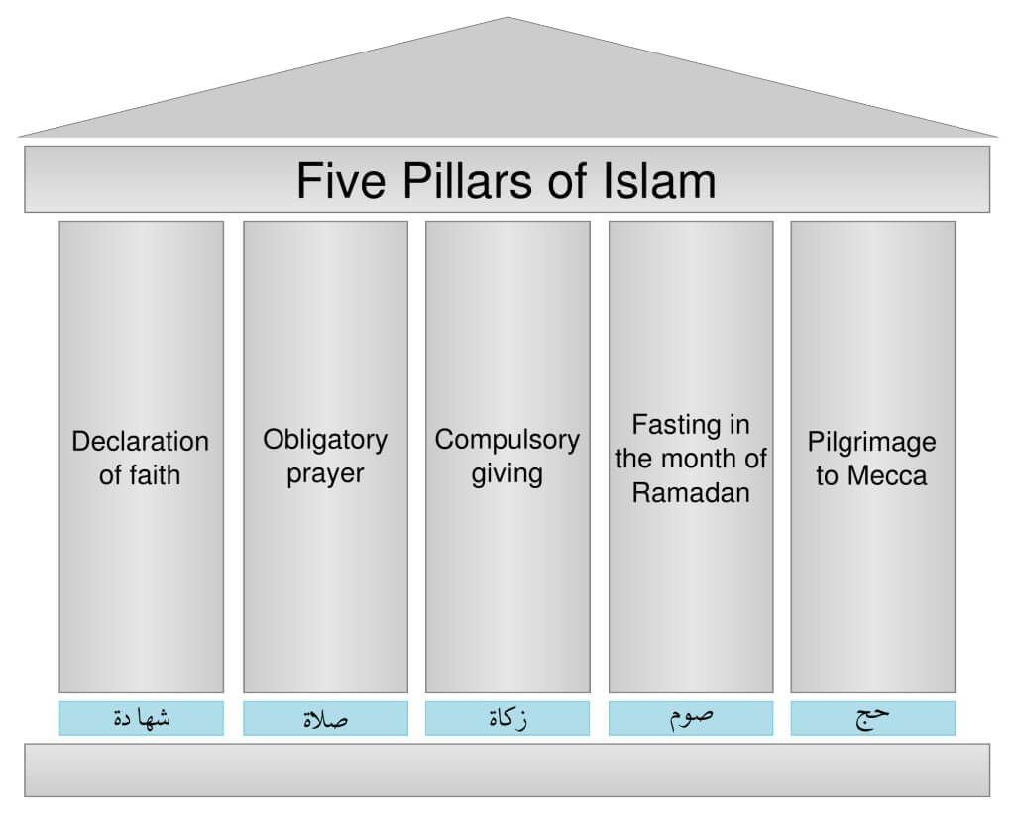
Fore face of Islam
"Islam is that you bear the witness that there is no one worthy of worship (God) except Allah and Muhammad is the messenger of Allah, and you establish Prayers, and you pay Charity, and you keep the Fasts of Ramadan, and you perform Hajj of the House if you can manage the way to it".
This hadith describes the face features of Islam by following five;
FAITH (Shahadatain, Eimaan)
PRAYERS (As-Salah)
CHARITY (Az-Zakah)
PILGRIMAGE (Al-Hajj)
FASTS (As-Saum)

Slide 8
Complete Structure of Islam
1:- Beliefs۔ 2:- Worships 3:-Dealing
1- Oneness of Allah 1 Prayers 1-Social Dealings
2- His angels 2-Charity 2-Money Dealings 3- His books 3-Fast
4- His messengers 4- Pilgrimage
5- Final day 5-Preaching +Holy War
6- The Destiny

Slide 9
Complete Structure of Islam
4:- Rules & Laws 5:- Ethics & Purification
1- Political system. 1- Concept of ethics
2- Legislative system. 2- Concept of Good & Evil
3- Judicial system. 3- Concept of Fair & Unfair
4- Ethical Values
5- Purification

Slide 10
Finality of Islam
Islam (The final version, revealed upon Muhammad PBUH) is the only religion with Almighty Allah in true sense.
"Truly, the religion with Allah is Islam".
Al Imran(3:18)
Also one should not die without believing and following Islam. As Allah has warned clearly in Qur'an stating.
“O you, who believe, be afraid of Allah, as He deserves to be feared, and let not yourself die save as Muslims.” (AL Imran 3:102)

Slide 11
Finality of Islam
The concept of success in true sense i.e. the success in afterlife totally depends upon following this final version of Islam, and there is no other possible way or key to success. No other religion is acceptable to Allah, the Lord and the Master of the Day of Judgment. Allah has announced it in Qur'an saying,
"And whoever seeks a religion other than Islam, It will never be accepted from him, and he, in the hereafter, will be among the losers". Al Imran3:85

Slide 12
Finality of Islam
Abu Huraira (r.a.) narrated that the messenger of Allah said; “I swear by the one who holds the life of Muhammad, any of the Jew or Christian from among the people who comes to know about me, and then dies without having faith in what I have been sent with (Islam), he will definitely be among the hell members”. (Muslim)

